Slide 1
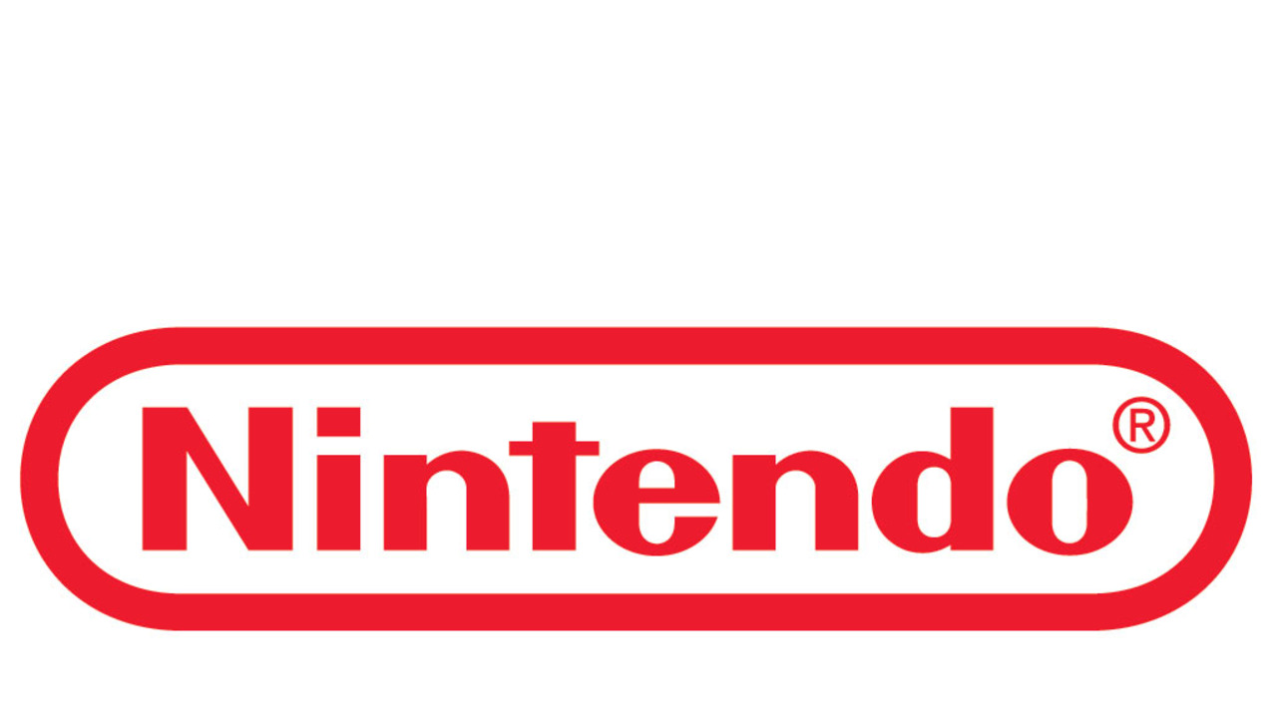

Case Study
Justin McLaughlin Justin Le
Dongeun Sul Timothy Winthrop

Slide 2

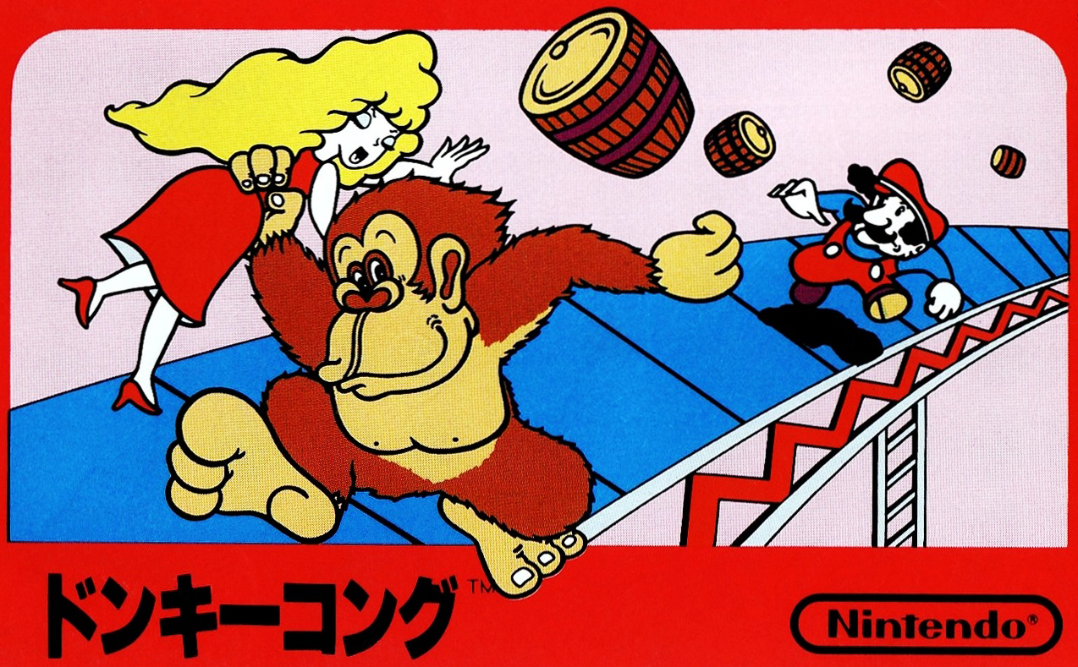
History
•Established in 1889 as a playing card manufacturer and distributor.
•Began development of electronic toys in 60s, and video games in 70s.
•Developed and sold GAME & WATCH in 1980, and the Donkey Kong arcade game in 1981.
•Famicom/NES in 1983/84
•Game Boy in 1989
•And so on….

Slide 3




History
•Grew from a small game and toy company into a multinational video game company with brand recognition worldwide
•Has divisions located in Japan, the US, the UK, and Australia

Slide 4

Strengths
Decades of experience in video game hardware and software development
Affordable product line compared to competitors
Strong international brand recognition, company name synonymous with “video game.”
Nintendo has a family friendly image

Slide 5


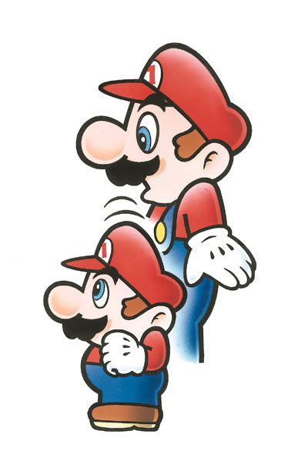

Weakness
High dependence on few gaming titles and Characters
Underpowered hardware
Poor Product Marketing Confuses Customers

Slide 6



Opportunities
With mobile gaming reaching a high in partnering of Nintendo
and another company, Nintendo is beginning to spread their reach
into the mobile industry.
As Nintendo’s competitors moving into virtual reality,
this opens a niche for which nintendo can focus on.
Nintendo’s goal is to create a console for gaming focused
equally on both at home and on the go play.

Slide 7


Opportunities
With their competitors not super strong in local multiplayer,
and their focus being more on online play--Nintendo may be
the best bet when considering games to play with your friends in person.
With increasing internet speeds and old content being re-released only as digital content.
Since Nintendo mainly focuses on releasing family oriented content, it has appeal to parents who are shopping for appropriate content for their children.

Slide 8



Threats
Sony and Microsoft are in direct competition with Nintendo and pose a threat due to the initial cost of game products, most consumers don’t own more than one or two consoles.
With the dawn of mobile games in an increase and people spending more time on
their phones, they’re less likely to purchase dedicated video game consoles over
playing games on their cell phones.
Due to being a company that participates in international markets, they are threatened
by fluctuating exchange rates on currency and different demographics from culture.
Possible increased competition from countries that are beginning to enter into
entrepreneurial markets in the future.
Third party developers often tend to develop for the competition because of higher
console sales or unfamiliarity with architecture of the consoles.

Slide 9


Slide 10

Conflicts between Nintendo and Third party developers. → Create incentives for third party developers. - Open seminar for third party
Open new market
→ Mobile game development.
Re-focus to successful demographics instead of trying to innovate.
→ Constant innovations between console to console alienates some successful demographics.

Slide 11
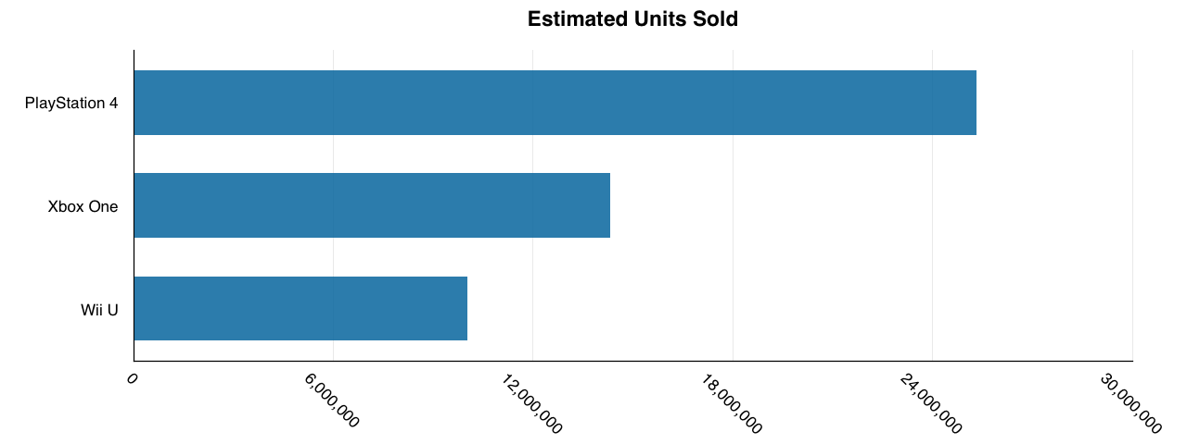
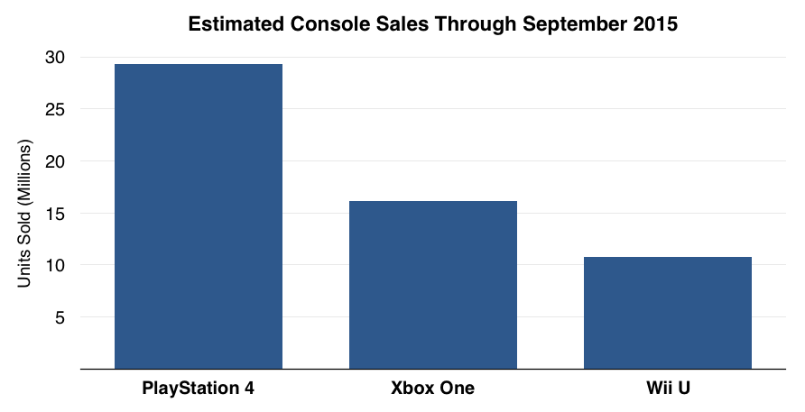
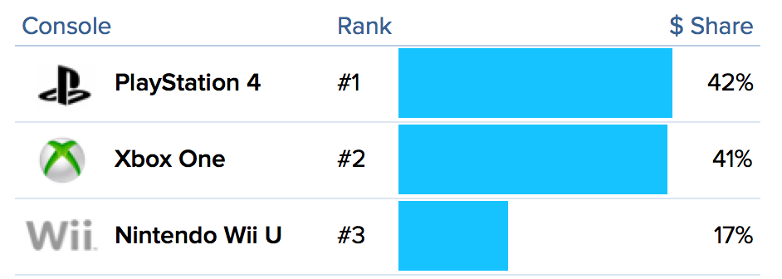

Slide 12
3 . Thorough and realistic market research.
4. Supply
2012 Wii U 12million (December 2015)

Slide 13

Thank you
For your attention

